Slide 1


Event-Driven AI: Supercharging ChatGPT with RAG & LangStream
Mary Grygleski
Senior Developer Advocate
@mgrygles
April 2024

Slide 2
Agenda
Who’s Mary?
A Brief Intro to ChatGPT and GenAI
Drawbacks of LLMs
Different options for improvement
Create your own LLM
Fine-tuning: Retaining your LLM on new data
Prompt engineering: Coaxing it to what you want
Retrieval Augmentation Generation (RAG)?
Retrieval Model
Generative Model
Here comes LangStream
Combining the best of both worlds: Event Streaming and Generative Model
Resources

Slide 3
Who is Mary?

Slide 4

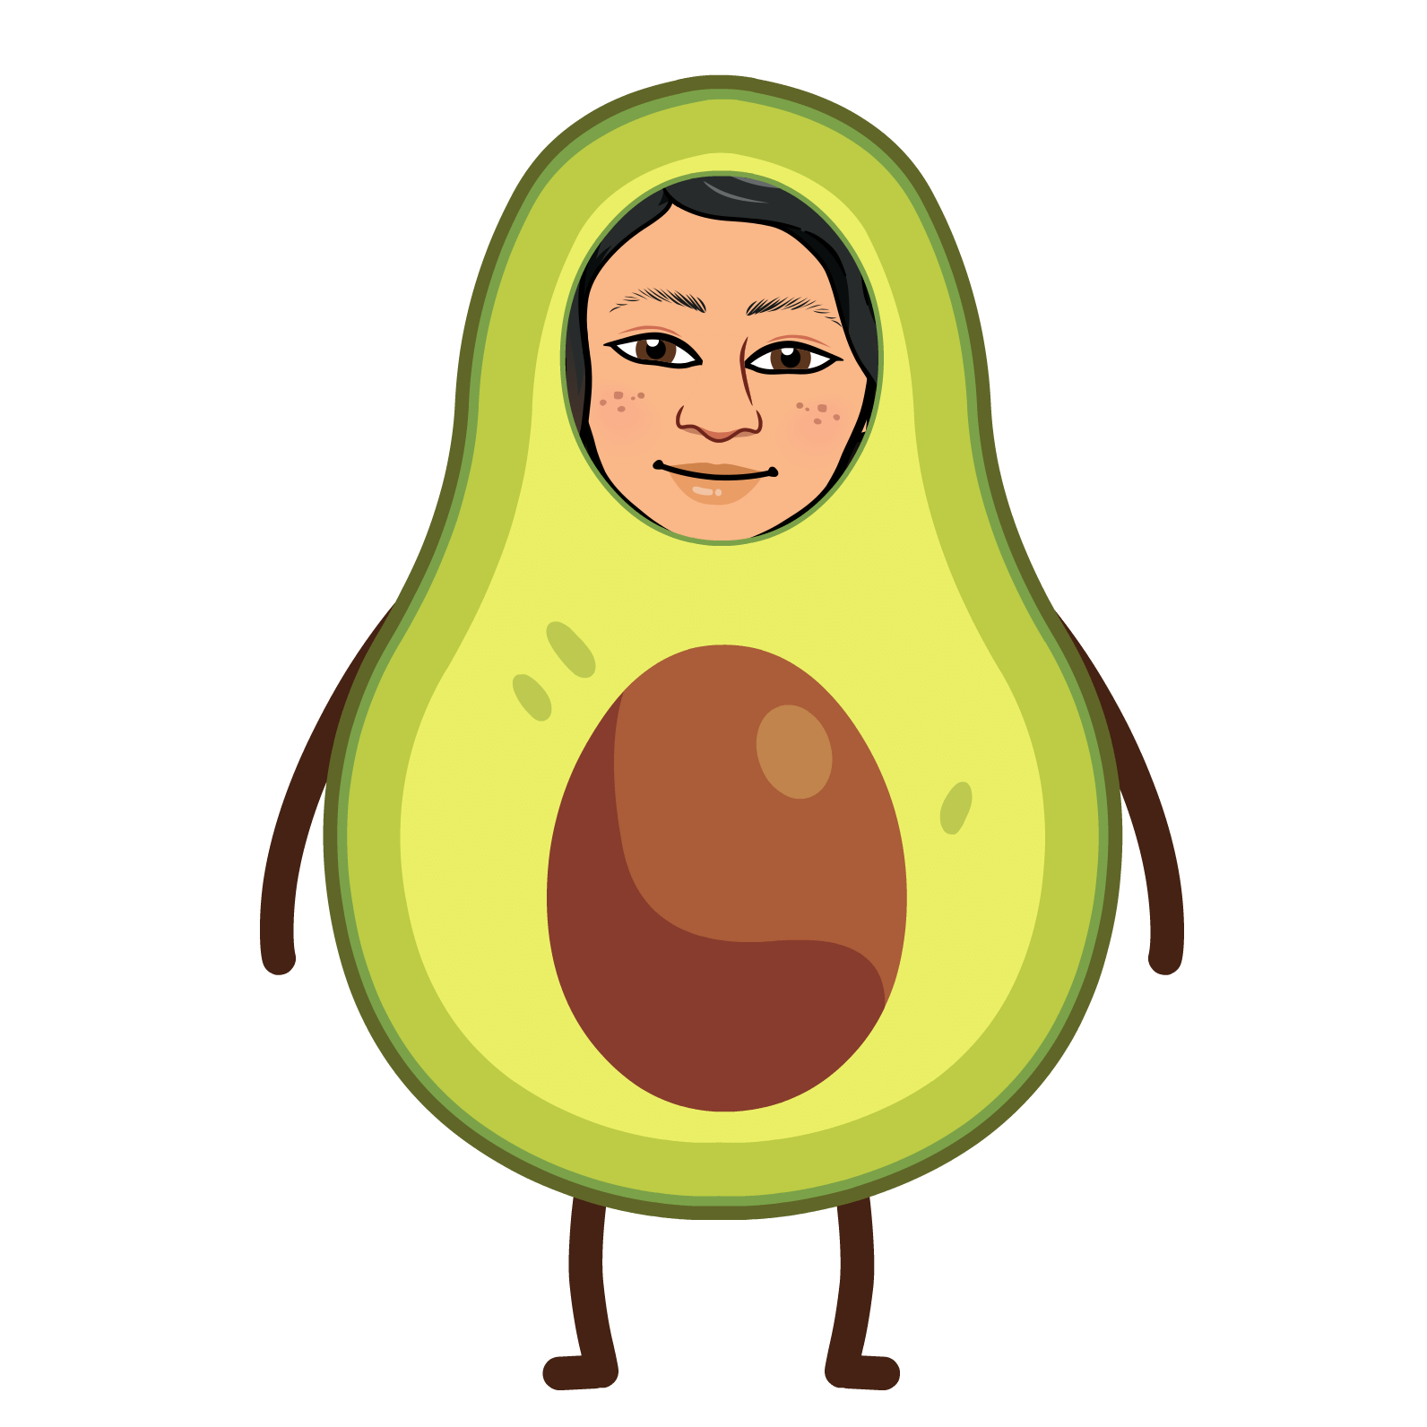




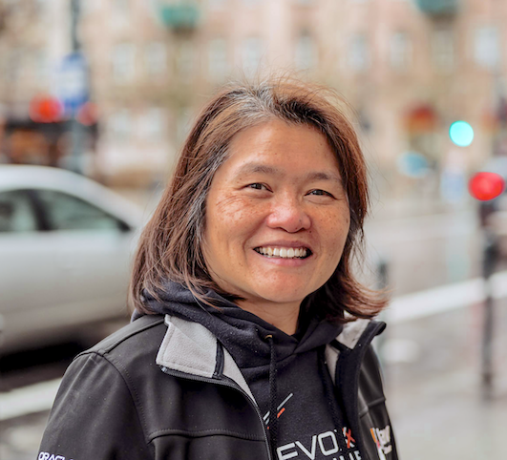


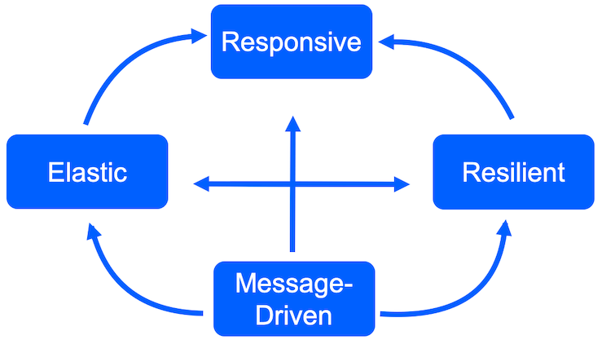




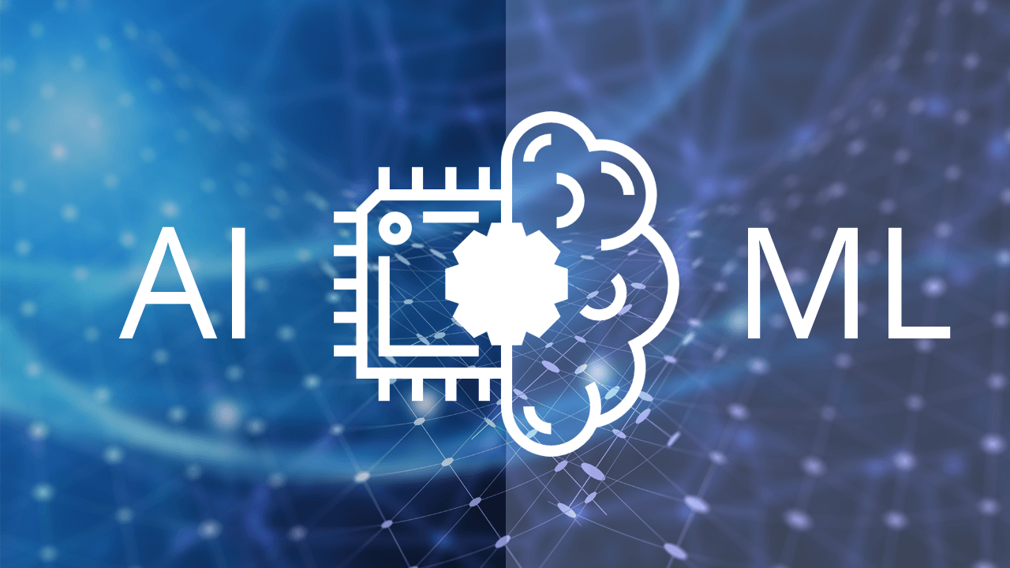


Senior Developer Advocate
Passionate Advocate
mgrygles
Java Champion
mary-grygleski
mgrygles
mgrygles
Streaming
Distributed Systems
Reactive Systems
IoT/MQTT
Real-Time AI/ML

Slide 5
A Brief Intro to GenAI / ChatGPT

Slide 6
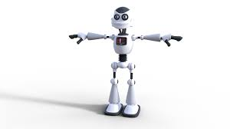
It’s all about
AUTOMATION

Slide 7
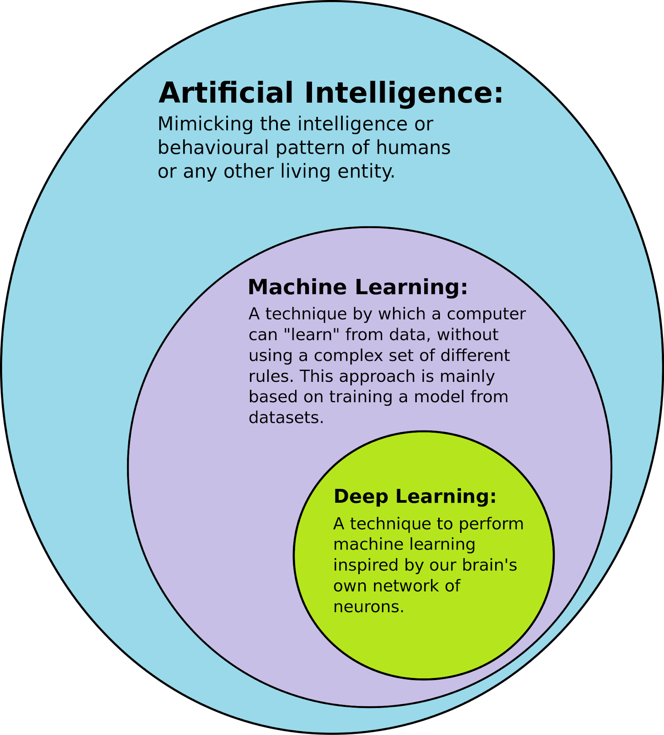

Slide 8
A fascinating look at the GenAI “era”

Slide 9
What is Generative AI (GenAI) ?
A “disruptive” field in AI
Has the potential to change the way we create and consume content
Generate new contents based on prompts
Uses a combination of machine learning and deep learning to produce contents
Tends to be on the “creative” side: generating code, writing an article, designing new fashion, composing a new song… especially when compared with Predictive AI which tends to be more strictly about business, marketing, and weather forecasting.

Slide 10
What is Generative Pre-Trained Transformer (GPT) ?
Takes simple prompts (in natural human language) as input
Pattern matching (also commonly being called as “search”
Answers questions for the prompts
Produce contents such as: a new essay, a blog post, a new computer program

Slide 11
GPT started showing up around 2018
2018: Alec Radford’s paper on generative pre-training (GPT) of a language model is republished on OpenAI’s website, showing how a generative language model can acquire knowledge and process dependencies unsupervised based on pre-training on a large and diverse set of data
2019: OpenAI releases the complete version of its GPT-2 language model, which was trained on a dataset of more than nine mission documents — including text from URLs shared in Reddit posts with at least three upvotes.

Slide 12
2020s: ChatGPT - a fast-growing AI Chatbot
2022: Startup company Stability AI develops Stable Diffusion, a deep learning text-to-image model that generates images based on text descriptions. This leads to the rise of other diffusion-based image services, such as DALL-E and Midjourney.
2022: ChatGPT releases GPT-3.5, an AI tool that reached one million users within five days. The tool can access data from the web from up to 2021.

Slide 13
2023: ChatGPT continues…
2023: The generative AI arms race begins. Microsoft integrates ChatGPT technology into Bing, a feature now available to all users. Google releases its own generative AI chatbot, Bard. And OpenAI releases yet another version of their bot, GPT-4, along with a paid “premium” option.
2023: OpenAI releases a beta version of its browser extension for ChatGPT (now available to all ChatGPT Plus subscribers), which has potentially unbounded access to current data on the web — something no other generative AI tool currently offers. It also announces the availability of third-party plugins.

Slide 14
What is Natural Language Processing (NLP)?
An interdisciplinary sub-field of linguistics of computer science
Primary concern is to process natural language datasets (as such text corpora or speech corpora)
Uses rule-based or probabilistic machine learning approaches
Enables computer to learn from contents, including the contextual nuances of the language itself
Ideally to draw insights from the documents

Slide 15
What is Large Language Models (LLMs)
A type of Machine Learning Model
Foundation type of model
Typically the pre-training consumes a humongous amount of resources: $$$$$$$ GPUs, multiple weeks of processing
Performs NLP tasks
Generates and classifies texts
Answers questions (prompts) just like a human: analyze sentiments, chatbot conversations, etc.

Slide 16




How can I work with LLMs?
(https://www.langchain.com/)
LlamaIndex (https://www.llamaindex.ai/)
Semantic Kernel (https://learn.microsoft.com/en-us/semantic-kernel/
PaLM (https://developers.generativeai.google/)
Hugging Face (https://huggingface.co/)

Slide 17
Java-based API Frameworks
Semantic Kernel - Java SDK (https://learn.microsoft.com/en-us/semantic-kernel/)
JLama (https://github.com/tjake/Jlama)
JVector (https://github.com/jbellis/jvector)
Langchain4J (https://github.com/langchain4j)
Llama2.java (direct port from Llama.c)

